Slide 1


Exploring
+

Slide 2
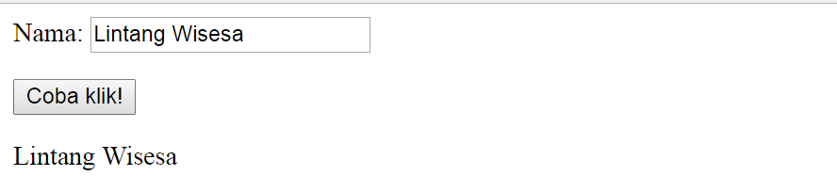
<form id="form">
Nama: <input type="text">
<br>
</form>
<button onclick="fungsiKu()"> Coba klik! </button>
<p id="tes"> Hasil </p>
<script>
function fungsiKu() {
let input1 = document.getElementById("form").elements[0].value;
document.getElementById("tes").innerHTML = input1;}
</script>
Input
Text

Slide 3
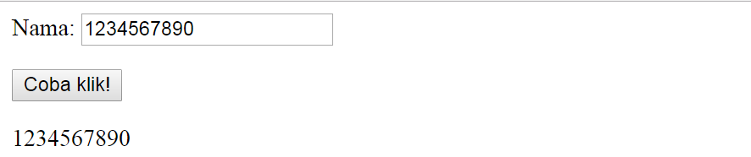
<form id="form">
Nama: <input type="number">
<br>
</form>
<button onclick="fungsiKu()"> Coba klik! </button>
<p id="tes"> Hasil </p>
<script>
function fungsiKu() {
let input1 = document.getElementById("form").elements[0].value;
document.getElementById("tes").innerHTML = input1;}
</script>
Input
Number

Slide 4
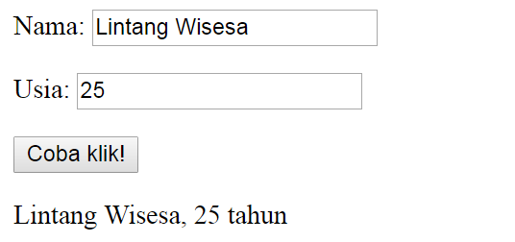
Input
Text & Number
<form id="form">
<p>Nama: <input type="text">
<p>Usia: <input type="number">
</form>
<button onclick="fungsiKu()"> Coba klik! </button>
<p id="tes"> Hasil </p>
<script>
function fungsiKu() {
let input1 = document.getElementById("form").elements[0].value;
let input2 = document.getElementById("form").elements[1].value;
document.getElementById("tes").innerHTML = input1+', '+input2+' tahun';}
</script>

Slide 5
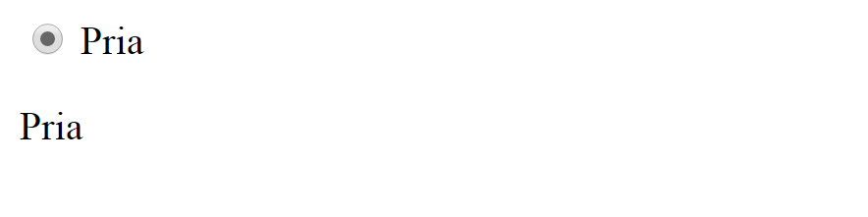
<input id="a1" type="radio" onclick="fungsiKu1(this.value)" value="Pria"> Pria
<br>
<p id="output"></p>
<script>
function fungsiKu1(y) {
if(document.getElementById("a1").checked==true){
document.getElementById("output").innerHTML = y}
else{document.getElementById("output").innerHTML = ''}
}
</script>
a Radio Button

Slide 6
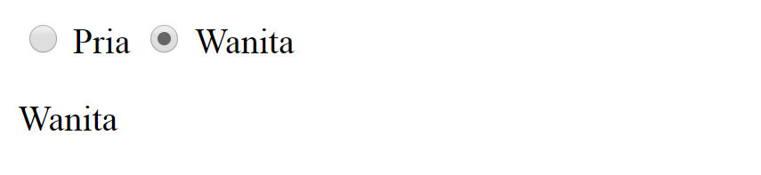
<input type="radio" name="sex1" onclick="fungsiKu2(this.value)" value="Pria"> Pria
<input type="radio" name="sex2" onclick="fungsiKu2(this.value)" value="Wanita"> Wanita
<p id="output"></p>
<script>
function fungsiKu2(y) {
document.getElementById("output").innerHTML = y
}
</script>
2 Radio Buttons

Slide 7
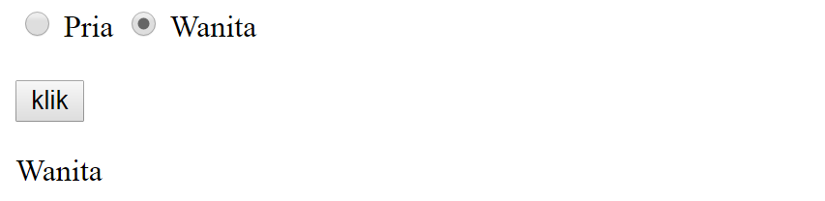
<input type="radio" name="sex" onclick="fungsiKu1(this.value)" value="Pria"> Pria
<input type="radio" name="sex" onclick="fungsiKu1(this.value)" value="Wanita"> Wanita
<button id="klikini" onclick="fungsiKu2(this.value)"> klik </button>
<p id="output"></p>
<script> function fungsiKu1(x) {
document.getElementById("klikini").value = x} function fungsiKu2(y) {
document.getElementById("output").innerHTML = y}
</script>
2 Radio Buttons

Slide 8
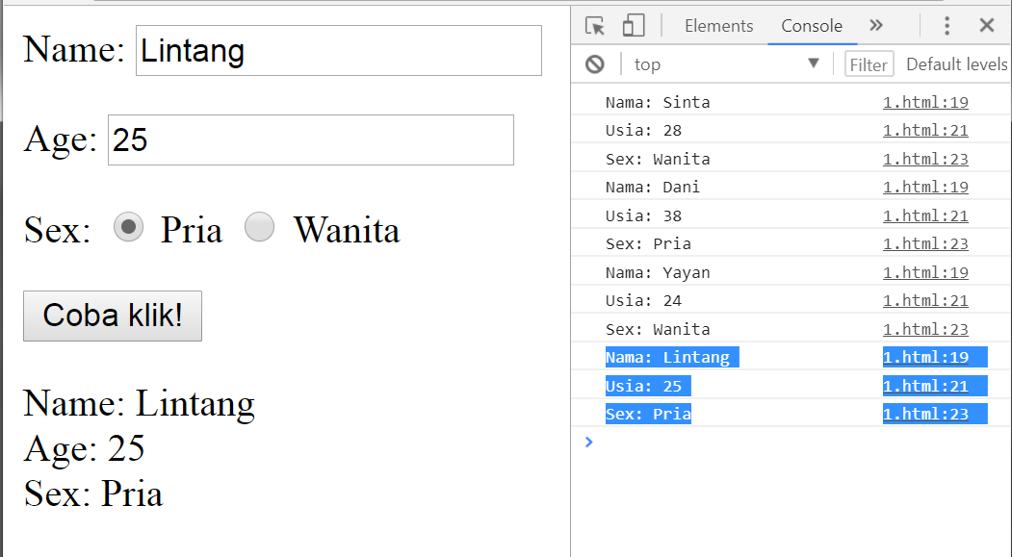
Solve It!

Slide 9

a CheckBox
<input id="a1" type="checkbox" onclick="fungsiKu1(this.value)" value="Pria"> Pria
<br>
<p id="output"></p>
<script>
function fungsiKu1(y) {
if(document.getElementById("a1").checked==true){
document.getElementById("output").innerHTML = y}
else{document.getElementById("output").innerHTML = ''}}
</script>

Slide 10
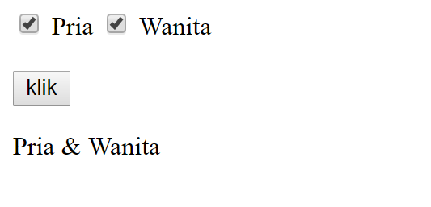
2 CheckBoxes
<input id="a1" type="checkbox" onclick="fungsiKu1(this.value)" value="Pria"> Pria
<input id="a2" type="checkbox" onclick="fungsiKu1(this.value)" value="Wanita"> Wanita
<br><br>
<button id="klikini" onclick="fungsiKu2(this.value)"> klik </button>
<p id="output"></p>

Slide 11
2 CheckBoxes
<script> function fungsiKu1(x) {
if(document.getElementById("a1").checked==true && document.getElementById("a2").checked==false){
document.getElementById("klikini").value = 'Pria'}
else if(document.getElementById("a1").checked==false && document.getElementById("a2").checked==true){
document.getElementById("klikini").value = 'Wanita'}
else if(document.getElementById("a1").checked==true && document.getElementById("a2").checked==true){
document.getElementById("klikini").value = 'Pria & Wanita'}
else{document.getElementById("klikini").value = ''}
}
function fungsiKu2(y) {
document.getElementById("output").innerHTML = y
}
</script>

Slide 12
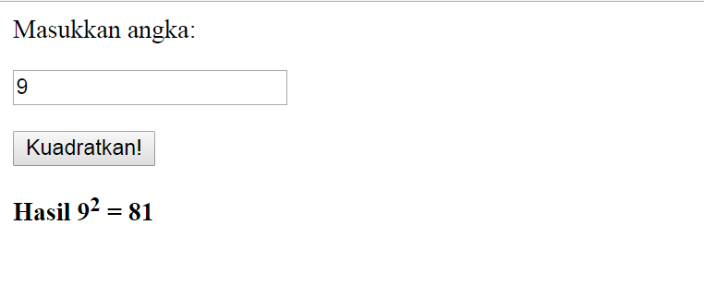
Solve It! #6
Program
Kuadrat

Slide 13
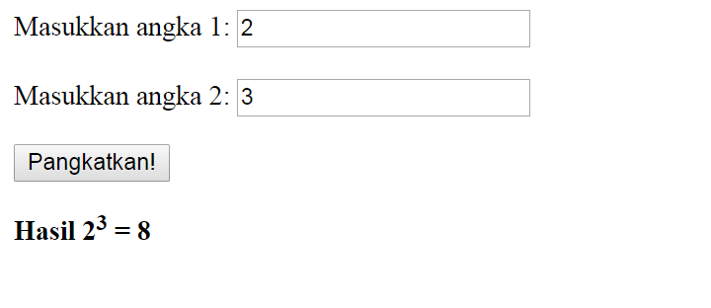
Solve It! #7
Program
Pangkat

Slide 14
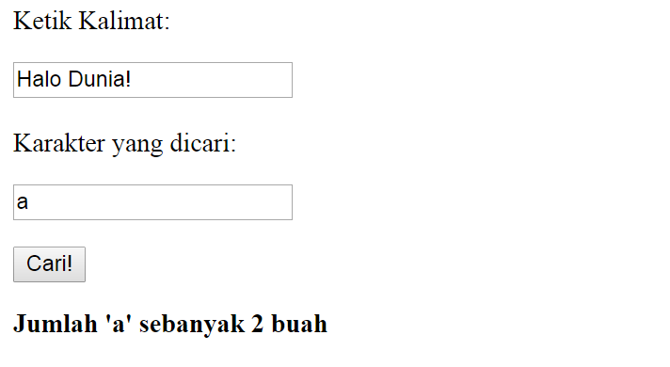
Solve It! #8
Pencarian
Karakter

Slide 15
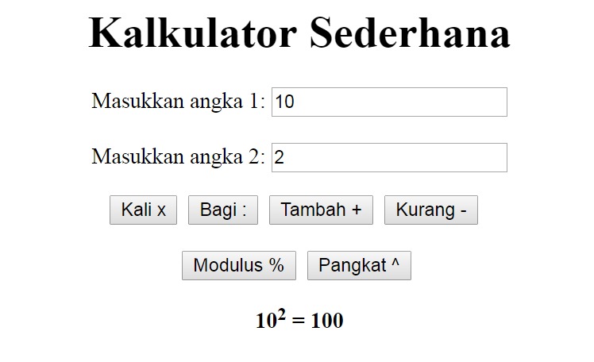
Solve It! #9

Slide 16
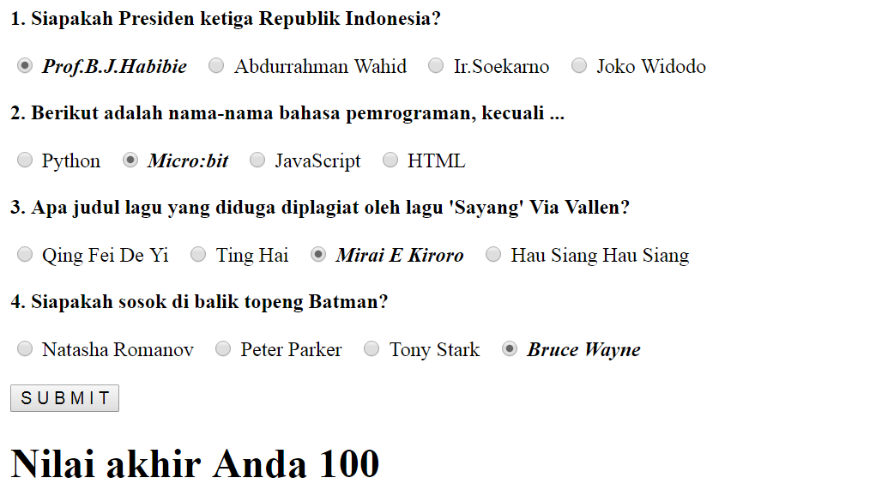
Solve It! #10

Slide 17
Exploring
+

